Slide 1

Problem Solving Using Computer
Course Code: BCAC 0018
Lecture – 13 & 14
Course: BCA I Year I Semester
By: Mr. Sanjiv Agrawal
Sanjiv.agrawal@gla.ac.in
+91-8923015116

Slide 2
Purpose of Program Planning
To write a correct program, a programmer must write each and every instruction in the correct sequence
Logic (instruction sequence) of a program can be very complex
Hence, programs must be planned before they are written to ensure program instructions are:
  Appropriate for the problem
  In the correct sequence

Slide 3
Algorithm
The step by step process to solve any logical and mathematical problem is called an algorithm.
An algorithm is a sequence of computational steps that transform input to desired output.
(Thomas H. Coreman)

Slide 4
Characteristics of Algorithm
All algorithms must satisfy the following five criteria:
Input
Output
Definiteness
Finiteness
Effectiveness

Slide 5
Characteristics of Algorithm
Input – It receives at least one input.
Output − It provides the desired output.
Definiteness − The Algorithm should be written in such a manner that its intent should be clear.
Finiteness – A good algorithm takes a finite number of steps before finishing.
Effectiveness – The Algorithm should be written in such a manner that it fulfill the purpose for that it is designed.

Slide 6
Flowchart
A flowchart is a diagrammatic representation of a problem-solving process in which steps are laid out in logical order.

Slide 7
Symbols Used in a Flowchart
  Oval (Start/Stop box): Used to indicate the start and end of the program.
  Rectangle (Process box): Indicates processes or actions.
  Parallelogram (Input / Output box): Indicates input and output of a program.
  Diamond (Decision box): Used in situation which demands one to choose either ‘Yes’ or ‘No’.
  Arrow line (Flow lines): Shows the flow of logic in a flowchart.

Slide 8
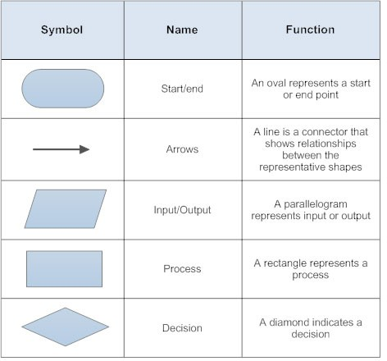

Slide 9
Levels of Flowchart
Flowchart that outlines the main segments of a program or that shows less details is a macro flowchart
Flowchart with more details is a micro flowchart, or detailed flowchart
There are no set standards on the amount of details that should be provided in a flowchart

Slide 10
Rules to Design Flowchart
Following are the rules to design flowchart:
  First chart the main line of logic, then incorporate detail.
  Words in the flowchart symbols should be common statements and easy to understand
  A flowchart should have only one Start and one Stop symbol.
  The general direction of flow in a flowchart is from top to bottom and from left to right.
  Arrowheads are used to indicate the flow of information or sequence of steps.
  The arrow lines should not cross each other.

Slide 11
Advantages of Flowchart
Better Communication
Proper program documentation
Efficient coding
Systematic debugging
Systematic testing

Slide 12
Limitations of Flowchart
Flowcharts are very time consuming and laborious to draw (especially for large complex programs)
Redrawing a flowchart for incorporating changes/ modifications is a tedious task
There are no standards determining the amount of detail that should be included in a flowchart

Slide 13
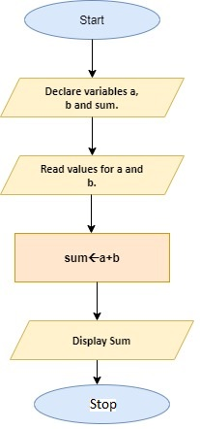
Algorithm Flow Chart
Step 1: Start
Step 2: Read values for a and b.
Step 3: Add a and b and assign the result to a variable sum.
Step 4: Display sum
Step 5: Stop

Slide 14
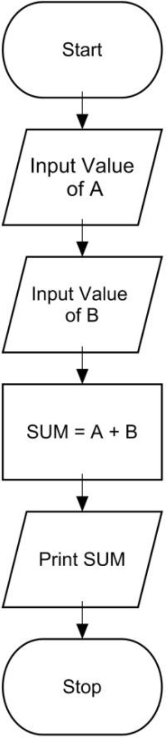
Algorithm & Flowchart to find the sum of two numbers
Algorithm
Step-1 Start
Step-2 Input first numbers say A
Step-3 Input second number say B
Step-4 SUM = A + B
Step-5 Display SUM
Step-6 Stop

Slide 15
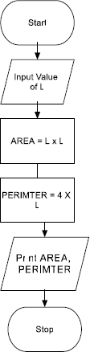
Algorithm & Flowchart to find Area and Perimeter of Square
Algorithm
Step-1 Start
Step-2 Input Side Length of Square say L
Step-3 Area = L x L
Step-4 PERIMETER = 4 x L
Step-5 Display AREA, PERIMETER
Step-6 Stop

Slide 16
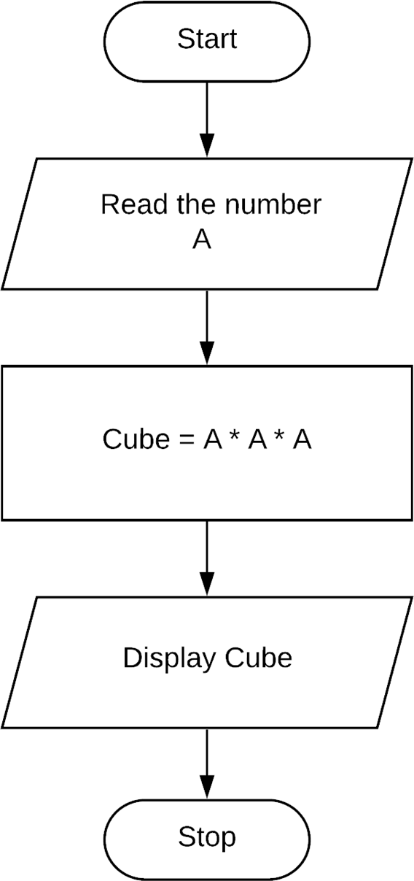
      Algorithm and Flowchart to Find the cube of a given number.
Algorithm
Step 1: Start
Step 2: Read the number and store it in a.
Step 3: Calculate cube of number as a * a * a
Step 4: Print cube of number
Step 5: Stop

Slide 17
Pseudocode
A program planning tool where program logic is written in an ordinary natural language using a structure that resembles computer instructions.
“ Pseudo” means imitation or false and “ Code” refers to the instructions written in a programming language. Hence, pseudocode is an imitation of actual computer instructions.
Because it emphasizes the design of the program, pseudocode is also called Program Design Language (PDL).

Slide 18
Example-1
Pseudo code for adding two numbers:
BEGIN
NUMBER s1, s2, sum
INPUT s1
INPUT s2
sum=s1+s2
OUTPUT sum
END

Slide 19
Advantages of Pseudocode
Converting a pseudocode to a programming language is much more easier than converting a flowchart to a programming language
As compared to a flowchart, it is easier to modify the pseudocode of a program logic when program modifications are necessary
Writing of pseudocode involves much less time and effort than drawing an equivalent flowchart as it has only a few rules to follow

Slide 20
Limitations of Pseudocode
In case of pseudocode, a graphic representation of program logic is not available
There are no standard rules to follow in using pseudocode
Different programmers use their own style of writing pseudocode and hence communication problem occurs due to lack of standardization
For a beginner, it is more difficult to follow the logic of or write pseudocode, as compared to flowcharting

